Slide 1
UNIT 1 : ELECTRIC POTENTIAL
(Chapter 24 Halliday Resnick, Fundamentals of Physics, 10th edition)

Slide 2
OBJECTIVES
Electric potential
Electric potential Energy
Relation between the electric potential and electric potential energy.
Motion of a charged particle in an electric field.
2

Slide 3

Electric Potential and Electric Potential Energy
We define the electric potential (potential) in terms of electric potential energy
Electric potential energy is analogous to the gravitational potential energy U.
Gravitational potential energy can be determined from the work W the gravitational force does if the object is moved up or down from that level (shown in Figure).
A tomato is thrown upward. As it rises, the gravitational force does negative work on it, decreasing its kinetic energy. As the tomato descends, the gravitational force does positive work on it, increasing its kinetic energy.
For either rise or fall, the change ΔU in gravitational potential energy = negative of the work done
Similarly if an electrostatic force acts between two or more charged particles in a system, if the charged particles are infinitely separated in the initial state, then
Potential energy U_{i} = 0
Let W∞ represent the work done by the electrostatic forces between the particles during the move in from infinity
Hence Final potential energy of the system is U = -W∞ (potential energy).

Slide 4
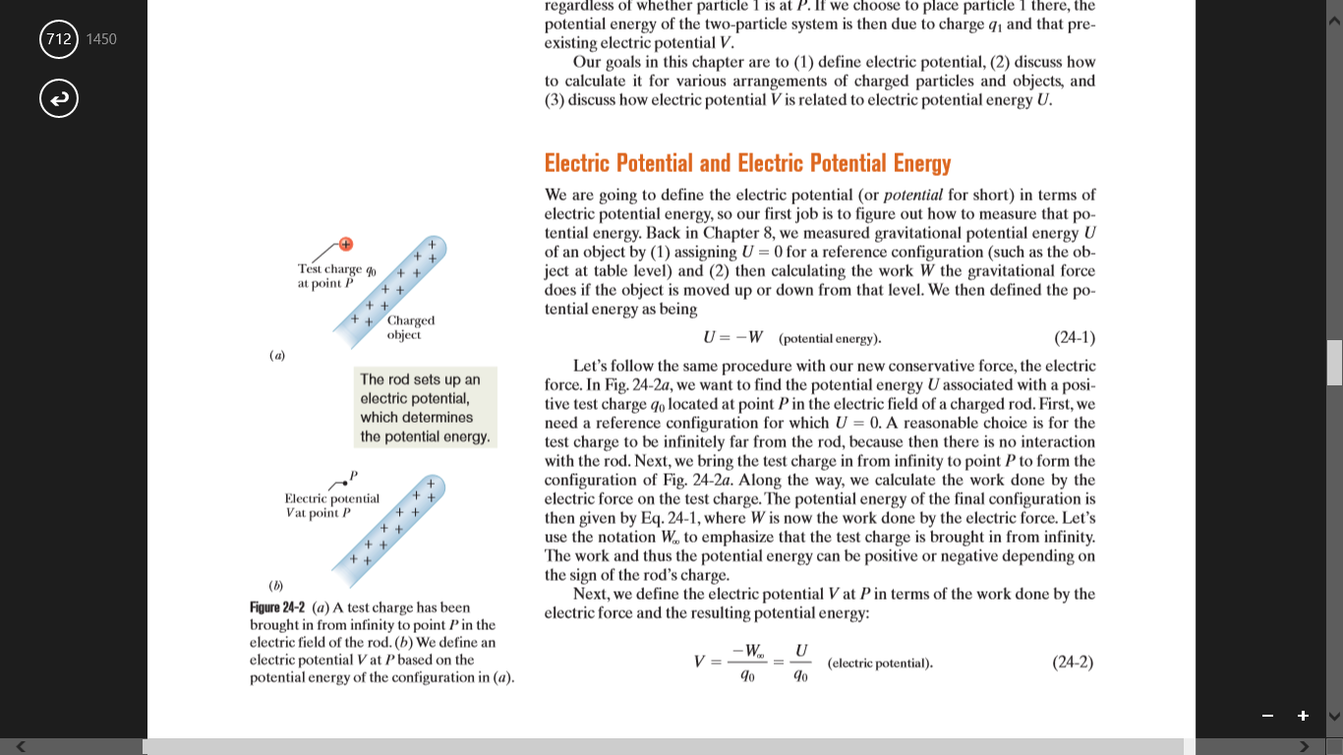
Electric Potential Energy
we want to find the potential energy U associated with a positive test charge q₀ located at point P in the electric field of a charged rod.
First, we need a reference configuration for which U = 0.
A reasonable choice is for the test charge to be infinitely far from the rod, because then there is no interaction with the rod.
Next, we bring the test charge in from infinity to point.
Along the way, we calculate the work done by the electric force on the test charge.
The work and thus the potential energy can be positive or negative depending on the sign of the rod’s charge.
Next, we define the electric potential V at P in terms of the work done by the electric force and the resulting potential energy:

Slide 5
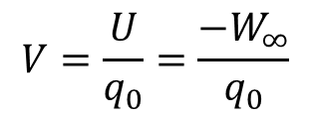
Electric Potential
Electric potential (V) is the electric potential energy (U) per unit charge when a positive test charge is brought in from infinity.
It has a unique value at every point in an electric field
V is a scalar quantity (because there is no direction associated with potential energy or charge)
It can be positive or negative (because potential energy and charge have signs).
SI unit is joule per coulomb
A more conventional unit for the electric field $\vec{E}$ is :

Slide 6

Calculating Electric Potential Energy from Electric Potential
We find that an electric potential is set up at every point in the rod’s electric field.
In fact, every charged object sets up electric potential V at points throughout its electric field.
Suppose a particle of charge q is placed at a point where its potential V is known, then the potential energy (U) of the configuration is:
$$Potential energy (U)=(Particles charge)\frac{potential energy}{charge}$$
$$U=qV$$
The potential energy of a charged particle in an electric field depends on the charge magnitude.
However, the potential energy per unit charge (electric potential) has a unique value at any point in an electric field.

Slide 7
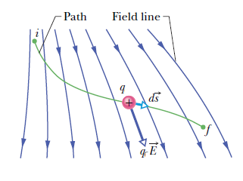
Motion of a charged particle through an Electric Field
Change in Electric Potential: If we move a test charge q from an initial point i to a point f in the electric field, the electric potential changes by
Potential difference depends only on the source charge distribution (Consider points i and f without the presence of the test charge;
The difference in potential energy exists only if a test charge is moved between the points.

Slide 8

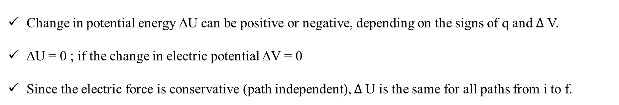
Motion of a charged particle through an Electric Field
Change in potential energy:
If we move the charge q from i to f, then, the potential energy of the system changes by
$$∆ U=q∆V$$
Change in potential energy ΔU can be positive or negative, depending on the signs of q and $∆$V.
ΔU = 0 ; if the change in electric potential ΔV = 0
Since the electric force is conservative (path independent), $∆$U is the same for all paths from i to f.

Slide 9


Motion of a charged particle through an Electric Field
Work done by the electric field : We can relate the potential energy change $∆$U to the work W done by the electric force as the particle moves from i to f by applying the general relation for a conservative force
W = - $∆$U
we can relate that work to the change in the potential by
W = - $∆$U =$q∆V=−q(V_{f}−V_{i})$
The work done by the electric field can be positive, negative, or zero.
Because $∆$U between any two points is path independent, so is the work W done by the electric field.

Slide 10
Motion of a charged particle through an Electric Field
Work Done by an Applied Force:
Suppose we move a particle of charge q from point i to point f in an electric field by applying a force to it.
W_{app} : work done by the applied force on the charged particle
W: Work done by the electric field
By the work–kinetic energy theorem of Eq. 7-10, the change ΔK in the kinetic energy of the particle is
Now suppose the particle is stationary before and after the move. Then K_{f} and K_{i} are both zero
Since
we find that
W_{app} can be positive, negative, or zero depending on the signs and magnitudes of q and ΔV

Slide 11
Equipotential Surfaces
Adjacent points that have the same electric potential form an equipotential surface
No net work W is done on a charged particle by an electric field when the particle moves between two points i and f on the same equipotential surface.
W = 0 if V_{f} = V_{i}
Because of the path independence of work (and thus of potential energy and potential),
W = 0 for any path connecting points i and f on a given equipotential surface regardless of whether that path lies entirely on that surface.

Slide 12
Equipotential Surfaces
Portions of four equipotential surfaces at electric potentials V₁ = 100 V, V₂ = 80 V, V₃ = 60 V, and V₄ = 40 V. Four paths along which a test charge may move are shown. Two electric field lines are also indicated.

Slide 13
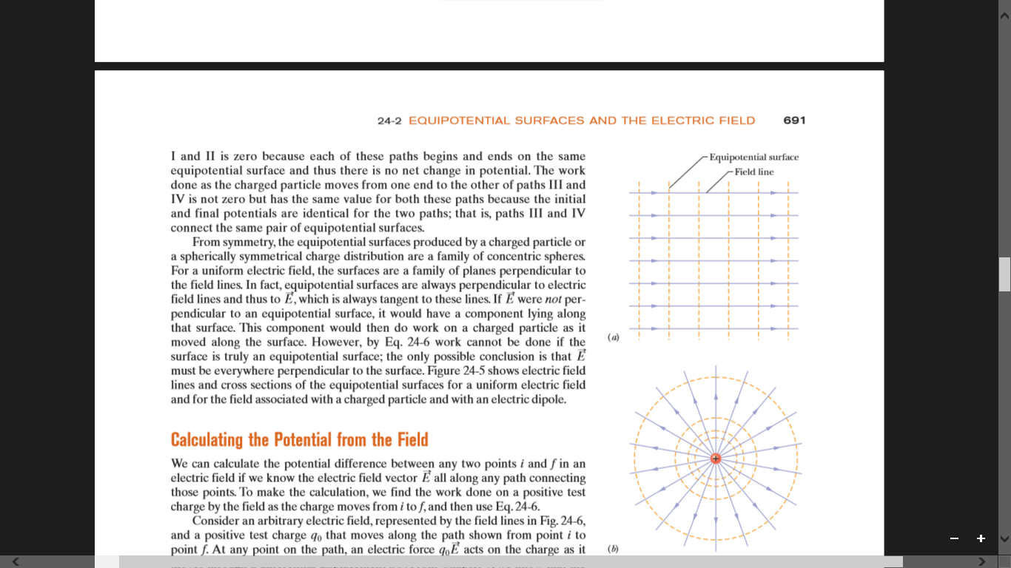
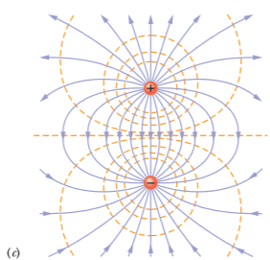
Equipotential Surfaces
Electric field lines (purple) and cross sections of equipotential surfaces (gold)
(a) a uniform electric field
(b) the field due to a point charge
(c) the field due to an electric dipole.

Slide 14
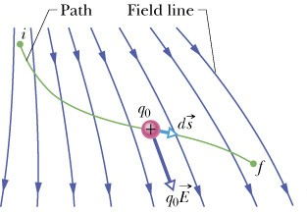
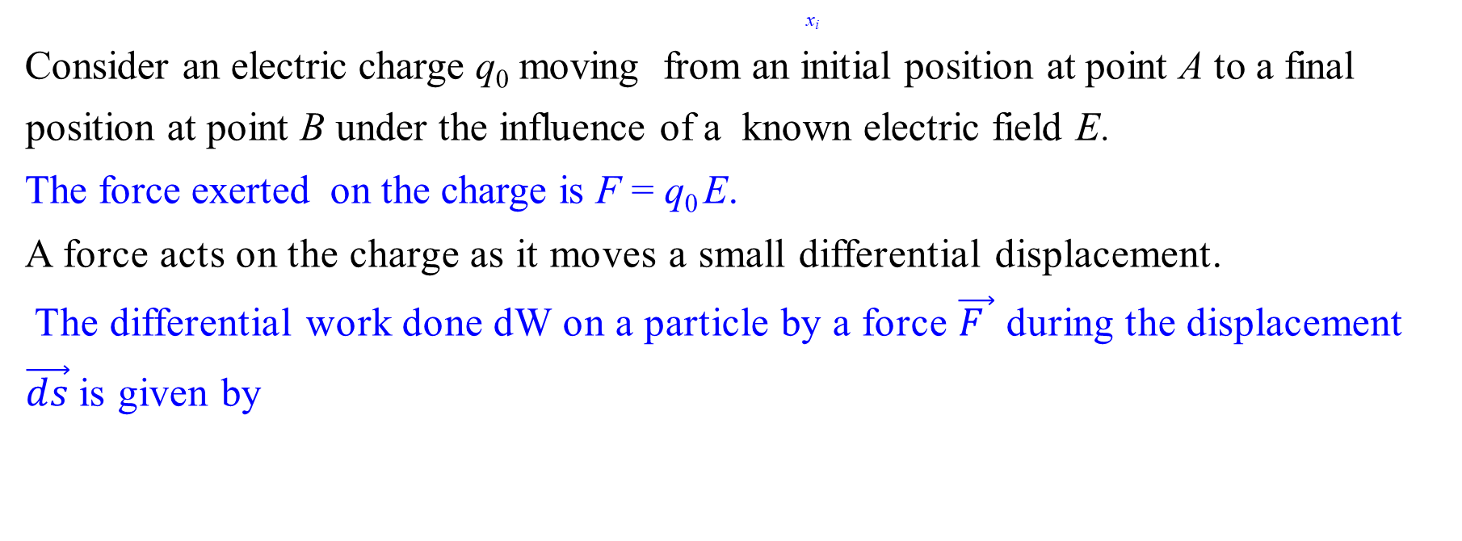

Calculating the Potential from the Field
x_{i}
Consider an electric charge q₀ moving from an initial position at point A to a final position at point B under the influence of a known electric field E.
The force exerted on the charge is F = q₀ E.
A force acts on the charge as it moves a small differential displacement.
The differential work done dW on a particle by a force $\vec{F }$ during the displacement $\vec{ds}$is given by
$$dW=\int_{i}^{f}{\vec{F}.\vec{ds}}$$

Slide 15
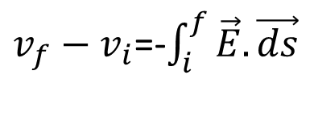
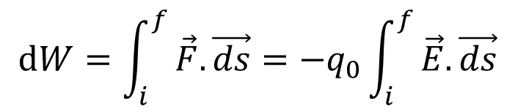
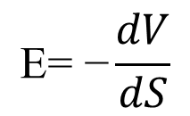

Calculating the Potential from the Field
To find the total work W done on the particle by the field as the particle moves from point i to point f, we sum—via integration—the differential works done on the charge as it moves through all the displacements along the path:
$$dW=\int_{i}^{f}{\vec{F}.\vec{ds}=−q_{0}}\int_{i}^{f}{\vec{E}.\vec{ds}}$$
$v_{f}−v_{i}$=-$\int_{i}^{f}{\vec{E}.\vec{ds}}$
Thus, the potential difference V_{f} - V_{i} between any two points i and f in an electric field is equal to the negative of the line integral from i to f.
By knowing electric field, we can calculate potential using the formula
$V$ = -$\int_{i}^{f}{\vec{E}.\vec{ds}}$
By knowing electric potential , we can calculate field using the formula
$$\text{E}\text{= }\text{−}\frac{dV}{dS}$$

